Slide 1
Sales Insights - Data Analysis Project using Tableau
By – Uzair Meran Khan.

Slide 2
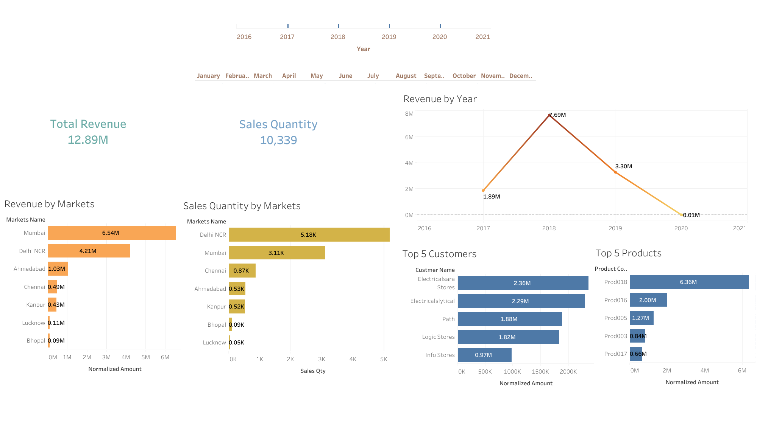

Slide 3
